Slide 1
Introduction to AI for Games Session 01
Course : COMP6228 – Artificial Intelligence
Effective Period : February 2018

Slide 2
TextBook: Ian Millington. 2009. Artificial intelligence for games. Morgan Kaufmann Publishers. Burlington. ISBN:9780123747310

Slide 3
Learning Objective
After completing this session, students are expected to be able to:
LO 1 : Describe how Artificial Intelligence works in Games

Slide 4
Content
What is AI
Why AI in Game?
Model of Game AI
Movement
Decision Making
Strategy
Algorithms, Data Structures, and Representations

Slide 5
What is Artificial
Intelligence (AI)?
Artificial intelligence is about making computers able to perform the thinking tasks that humans and animals are capable of.
We can already program computers to have superhuman abilities in solving many problems: arithmetic, sorting, searching, and so on. We can even get computers to play some board games better than any human being
But there are many things that computers aren’t good at which we find trivial: recognizing familiar faces, speaking our own language, deciding what to do next, and being creative.

Slide 6
What is Artificial
Intelligence (AI)?
In academia, some AI researchers are motivated by
philosophy: understanding the nature of thought and the nature of intelligence and building software to model how thinking might work.
psychology: understanding the mechanics of the human brain and mental processes.
engineering: building algorithms to perform human-like tasks.
As games developers, we are primarily interested in only the engineering side: building algorithms that make game characters appear human or animal-like.

Slide 7
What is Artificial
Intelligence (AI)?
ACADEMIC AI
Academic AI is divided into three periods:
the early days
the early days include the time before computers
the symbolic era
A symbolic system is one in which the algorithm is divided into two components: a set of knowledge and a reasoning algorithm that manipulates those symbols
the modern era
AI researchers realized that the key ingredient of this new approach was not so much the connection to the natural world, but the ability to handle uncertainty and the importance it placed on solving real-world problems.

Slide 8
What is Artificial
Intelligence (AI)?
Engineering
AI a key technology that is relevant to solving real-world problems
The only way any algorithm can outperform another is to focus on a specific set of problems. The narrower the problem domain you focus on, the easier it will be for the algorithm to shine.
There is now a concerted effort among some of the top statistical AI researchers to create a unified framework for symbolic and probabilistic computation.

Slide 9

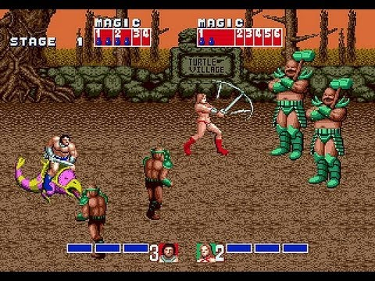
What is Artificial
Intelligence (AI)?
GAME AI
Pac-Man (1979) was the first game many people remember playing with fledgling AI.
Pac-Man relied on a very simple AI technique: a state machine
Game AI didn’t change much until the mid-1990s. Most computer-controlled characters prior to then were about as sophisticated as a Pac-Man ghost.
There is a classic like Golden Axe (1987) eight years later
In the mid-1990s, AI began to be a selling point for games.
Games like Beneath a Steel Sky (1994) even mentioned AI on the back of the box

Slide 10
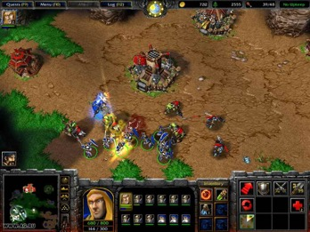

What is Artificial
Intelligence (AI)?
GAME AI
Some other games involving AI are:
Goldeneye 007 (1997)
Thief: The Dark Project (1998)
Metal Gear Solid (1998)
Warcraft (1994)
Warhammer: Dark Omen (1998)
Creatures (1997)
The Sims (2000)
Black and White (2001)
Full Spectrum Warrior (2004)
The AI in most modern games addresses three basic needs:
the ability to move characters
the ability to make decisions about where to move
the ability to think tactically or strategically

Slide 11
Why AI in Game?
Generate Responsive & Intelligent Behaviour
Generate Human-Like Behaviour
Experience when playing games
Game Mechanics & Game Design
The ultimate goal to create a responsive & intelligent human like behaviour using AI in games is to create experiences and increase the player’s immersion when playing the game (e.g. the player has the illusion that the NPC can think and interact like human) (for example: see Chowanda, A., Flintham, M., Blanchfield, P., & Valstar, M. 2016, September. Playing with social and emotional game companions. In International Conference on Intelligent Virtual Agents (pp. 85-95). Springer International Publishing.Chicago) .

Slide 12
Why AI in Game?
Intelligence NPC posing more of a challenge for the player
The game requires extra time to finish
The game and The NPC are less repetitive
Game Experience and Immersion for Player

Slide 13
PURE AI vs GAME AI
Interested in creating systems as smart as possible
Optimal solutions to real-world problems
Would make NPC fights as effectively as possible
Create “realistic simulations” of intelligence
Enhance the players experience
Game AI aims to make an immersive experience
PURE AI
GAME AI
The purpose of Game AI is for Entertainment, not problem solving

Slide 14
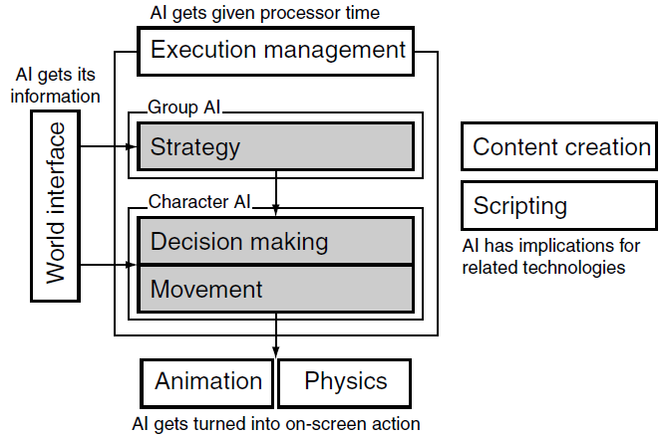
Model of Game AI
The model splits the AI task into three sections: movement, decision making, and strategy.
The first two sections contain algorithms that work on a character-by character basis, and the last section operates on a whole team or side. Around these three AI elements is a whole set of additional infrastructure

Slide 15
Model of Game AI
MOVEMENT
Movement refers to algorithms that turn decisions into some kind of motion. When an enemy character without a gun needs to attack the player in Super Mario Sunshine (2002), it first heads directly for the player.
Movement algorithms can be more complex than simply homing in. A character may need to avoid obstacles on the way or even work their way through a series of rooms. A guard in some levels of Splinter Cell (2002) will respond to the appearance of the player by raising an alarm.
Lots of actions are carried out using animation directly. If a Sim, in The Sims, is sitting by the table with food in front of him and wants to carry out an eating action, then the eating animation is simply played.

Slide 16
Model of Game AI
DECISION MAKING
Decision making involves a character working out what to do next. Typically, each character has a range of different behaviors that they could choose to perform: attacking, standing still, hiding, exploring, patrolling, and so on.
At its simplest, a character may have very simple rules for selecting a behavior. The farm animals in various levels of the Zelda games will stand still unless the player gets too close, whereupon they will move away a small distance.
At the other extreme, enemies in Half-Life 2 (2004) display complex decision making, where they will try a number of different strategies to reach the player: chaining together intermediate actions such as throwing grenades and laying down suppression fire in order to achieve their goals.

Slide 17
Model of Game AI
STRATEGY
Strategy refers to an overall approach used by a group of characters. In this category are AI algorithms that don’t control just one character, but influence the behavior of a whole set of characters. Each character in the group may (and usually will) have their own decision making and movement algorithms, but overall their decision making will be influenced
by a group strategy.
In the original Half-Life (1998), enemies worked as a team to surround and eliminate the player. One would often rush past the player to take up a flanking position. This has been followed in more recent games such as Tom Clancy’s Ghost Recon (2001) with increasing sophistication in the kinds of strategic actions that a team of enemies can carry out.

Slide 18
Algorithms, Data Structures, and Representations
Algorithms are step-by-step processes that generate a solution to an AI problem
Data structures are the other side of the coin to algorithms
Often, a set of algorithms is presented that gets increasingly more efficient
Performance Characteristics
Some algorithms have confusing performance characteristics. It is possible to set up highly improbable situations to deliberately make them perform poorly.
Pseudo-Code
Pseudo-code is a fake programming language that cuts out any implementation details particular to one programming language, but describes the algorithm in sufficient detail so that implementing it becomes simple.

Slide 19
Algorithms, Data Structures, and Representations
Representations
Representations are a key element of AI, and certain key representations are particularly important in game AI.
For example, imagine we want to work out if a character feels healthy or not as part of some algorithm for determining its actions. We might simply require a representation of the character with a method we can call:
class Character:
# Returns true if the character feels healthy,
# and false otherwise.
def feelsHealthy()

Slide 20
References
Ian Millington. 2009. Artificial intelligence for games. Morgan Kaufmann Publishers. Burlington. ISBN:9780123747310
Chowanda, A., Flintham, M., Blanchfield, P., & Valstar, M. (2016, September). Playing with social and emotional game companions. In International Conference on Intelligent Virtual Agents (pp. 85-95). Springer International Publishing.Chicago

